Slide 1
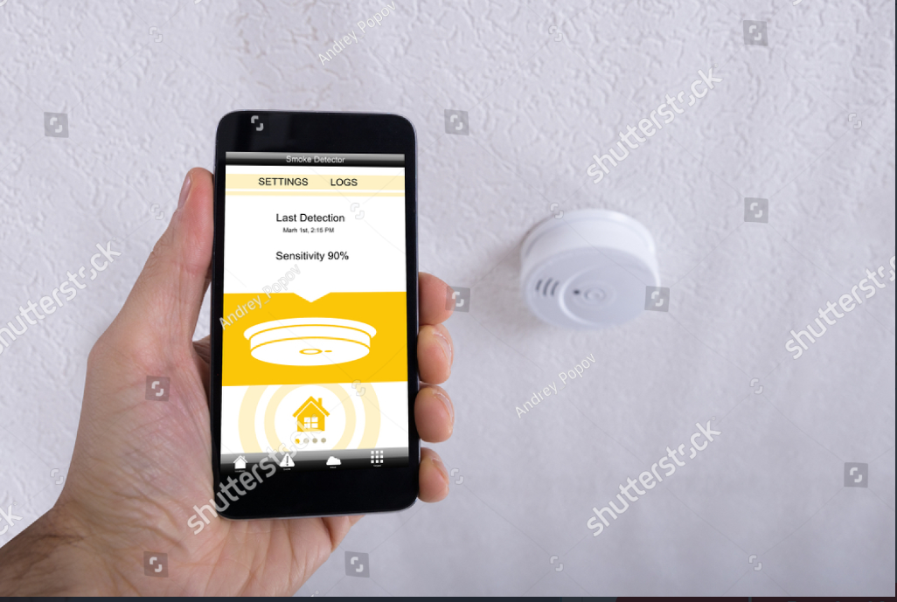
IOT Course Fire force control board
Bayan Taha
Bar Naim
Lina DACCA
Guy koren

Slide 2

OUR VISION
The product we’ve developed is a smart system that manages alerts from smoking detectors around the country and ease the event’s management and communication between the firemen and the client when such happen.
Our goal is to improve and enhance the ability to manage situations where smoking detectors alert on fire, and hence increasing the chance to take over fires as fast as possible, reduce losses and coasts and rescue human life.

Slide 3
General product information
Client side (Application):
Smart and easy registration and identification process
Easy and comfortable management of the devices including device history and details
Visualizing all devices on map with the ability to choose each
Being alert when one of your devices detected smoke (with all relevant information of the device)
Fire department side (Website):
Contain data of all relevant stations, devices and client’s details
Devices statistics and graphs for future learning (based on firemen’s alert report)
Tool for managing open alerts and navigate there while showing ETA
Being alert when a device detected smoke (with all relevant information of client and device)
Shared:
Live chat to improve contact (both sides can declare the alert as false alarm)

Slide 4

New registration
A new client register in the registration page
Filling identification details (+Forgot password question)
Tools to validate those fields (valid email, confirm password, valid phone number exc..)
After the registration, a new user is being stored in client’s table

Slide 5
Logging in
User log in by email address and password
Tools to validate the password correctness
Forgot password option - compares the validation question
After logging in, listing all the devices owned by user

Slide 6
New device
Adding devices by their name (unique identifier for each user) and location details – device is being store in device’s table
In addition, a device keeps transmitting its coordinates for better positioning
Easy management of devices (delete exc..)
Can watch device’s location on map
Can watch the alert’s history of the device (with details)

Slide 7

Urgent alerts
A list of all current alerts and their details
“Is alerting” sign flickering (unless user marked as “false alarm”)
Can see alert’s location on map and navigate there (with trip details and ETA) by choosing origin station
Converting longitude and latitude into city using google maps API
Chat with the device owner
Submitting the event send it to device’s history table (filling the relevant details of the event)

Slide 8
Events history
A list of all the events and their details
Interactive monitoring tools for pattern’s learning and future analysis:
1. Number of events per day for the last 30 days
2. Total events per city (with percentages)
3. Number of events for each number of injured

Slide 9
more
Watch all devices on map
About us

Slide 10
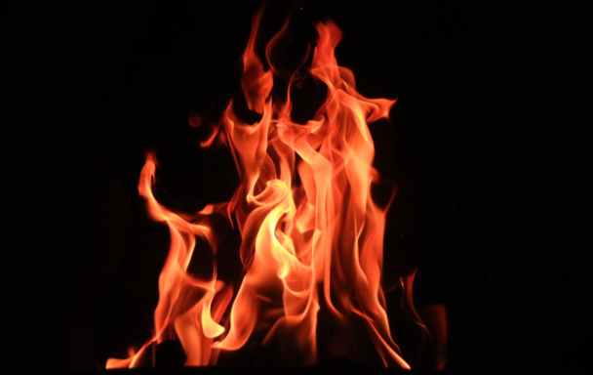
New event
The device detect smoke (we use simulation)
Sending the details to both fire department and client
Client can mark false alarm (sends to fire department)
Fire department can watch the device on map, choose station and navigate there (trip details are shown on map)
Chat between firemen and client for better communication
Only fire department can “close” the event (adding details)

Slide 11
Simulating the events
We’ve created a script with 2 options (depend on the IOT Hub massage)
Simulating an alert (i.e. simulating an alerting smoking detector)
Simulating clients – adding to all relevant table the client’s / device’s / alert’s / event’s details (as much as we choose)

Slide 12

Azure tables (using storage account)
Three azure tables stored in cloud
Clients table (Stores all client's details – new row when a new client register)
Current alerts table (Stores all open cases – new row when device alerts, delete row when fire department closes the event)
Devices table (Stores all device’s details – new row when adding a device, delete row when deleting it)

Slide 13

Azure cosmos Db tables
One cosmos DB table
Events history table (Stores all closed event’s details – new row when fire department closes an alert)
Enable more complicated analysis and statistics tools using SQL queries
Used for visualizing monitoring graphs and update them with every new event
# This resource is more expensive then azure tables, therefor we didn’t store all our tables like that

Slide 14

Azure functions
We’ve used azure functions to access databases, alerting, navigate between pages exc..
HTTP Triggered functions: Most of our function. especially for accessing databases, updating and navigating
Event triggered functions: Being triggered by the event hub when device is alerting in order to acknowledge all the relevant.
# Used azure app services to publish them

Slide 15

Azure signalr
New alert (App) - Inform the client that there is an alert in one of his devices
Is false alarm (App) – Client can inform firemen that the alarm is false alarm
New alert (Web) – Inform the fire department that there is a new alert
Chat (App/Web) - communication between firemen and client

Slide 16

Azure iot hub
Connect to the device for gathering data
When new alert is on, the device send a massage to the IOT Hub that process the data and sends to the event hub (simulation)
Two ways communication – can also turn the device alert off (we didn’t implement this because we did not get the device)

Slide 17

Azure Event hub
Whenever gets a massage from the IOT hub, an event function is triggered by the event hub
Can process huge amount of alerts simultaneously

Slide 18

Azure pipelines
Build test and deploy the code
Connect to GitHUB to deploy continuously

Slide 19


